Slide 1
Version Control

Slide 2
GIT Bash Terminal
Download: https://git-scm.com/download/win

Slide 3
Installing GIT Bash Terminal

Slide 4
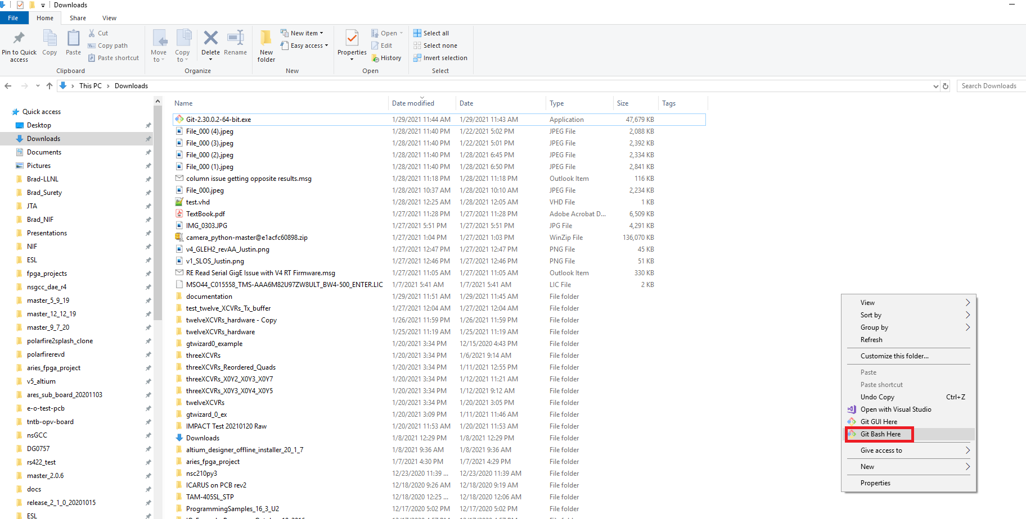
Starting GIT Bash
Right click anywhere in desired local drive on Windows Explorer
Select GIT Bash

Slide 5
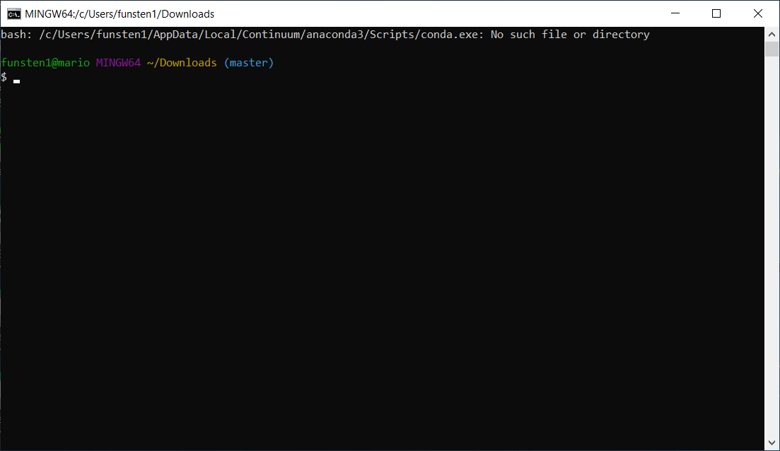
GIT Bash

Slide 6
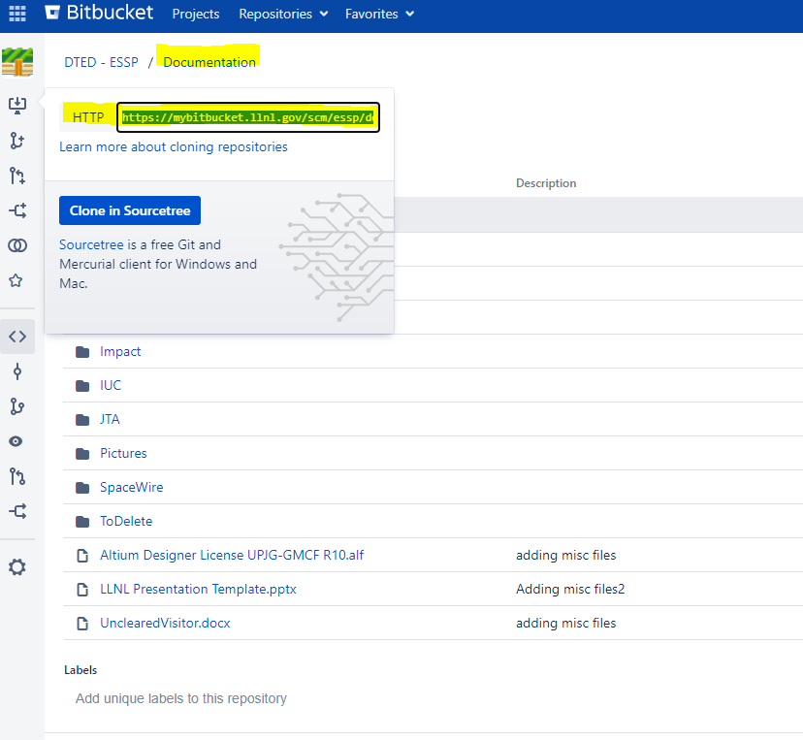
Copy the http link from Bitbucket for a Repository

Slide 7
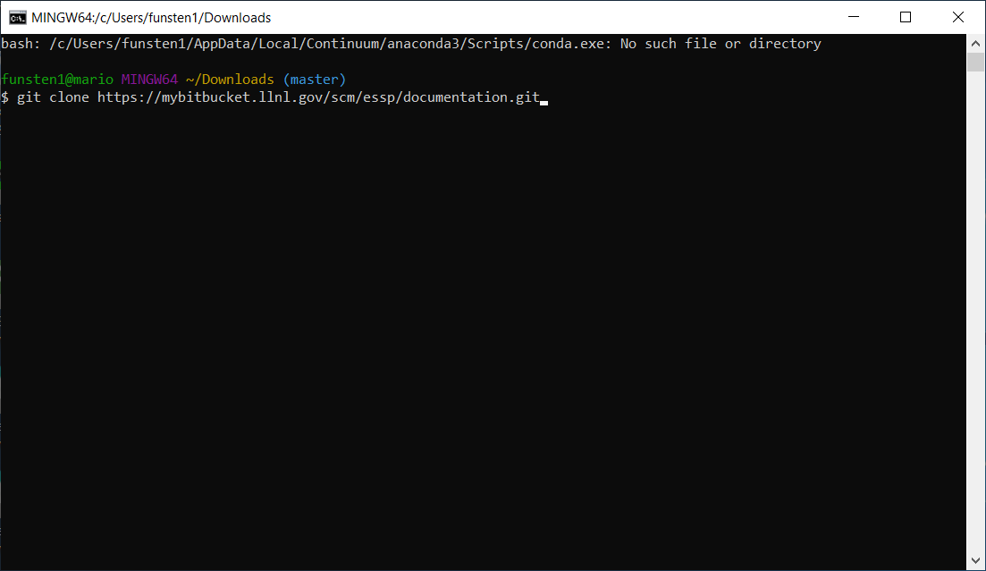
Clone repository with command: ‘git clone <http link>’

Slide 8
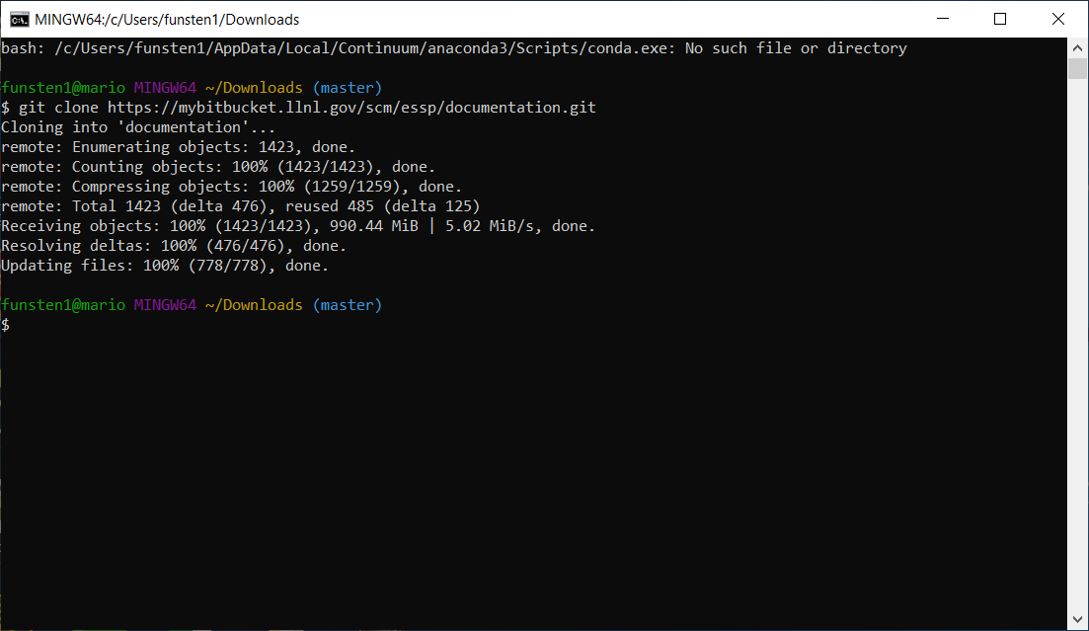
When finishing cloning repo

Slide 9
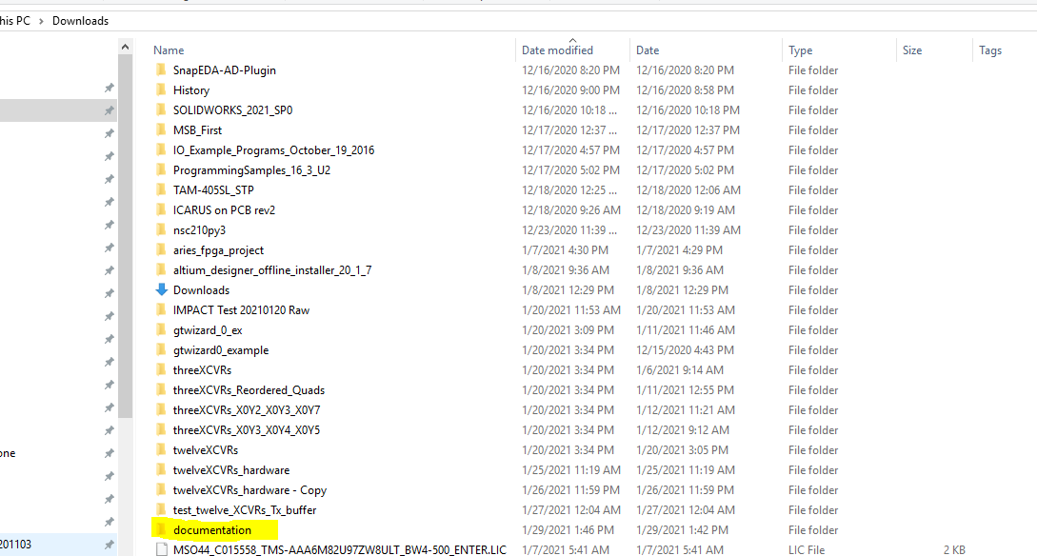
Verify repo is cloned on local drive

Slide 10
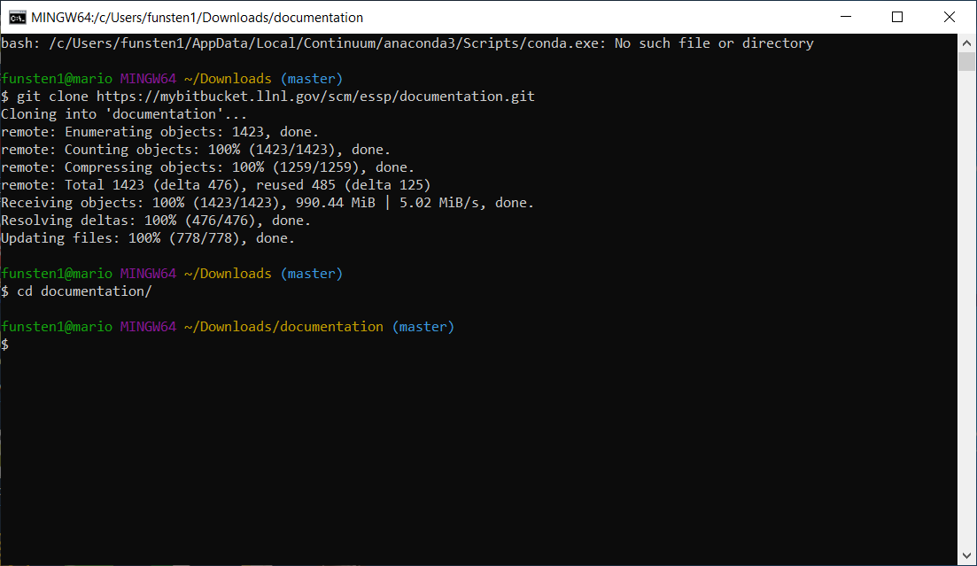
Change directory into cloned repo

Slide 11
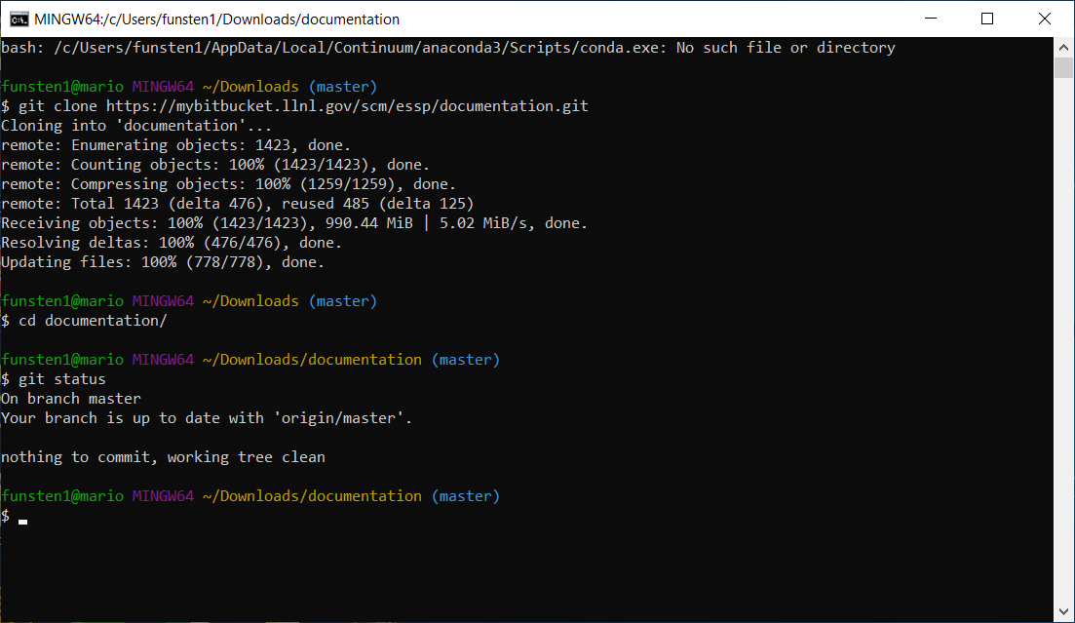
Perform a git command such as ‘git status’ to view the status of the repo

Slide 12
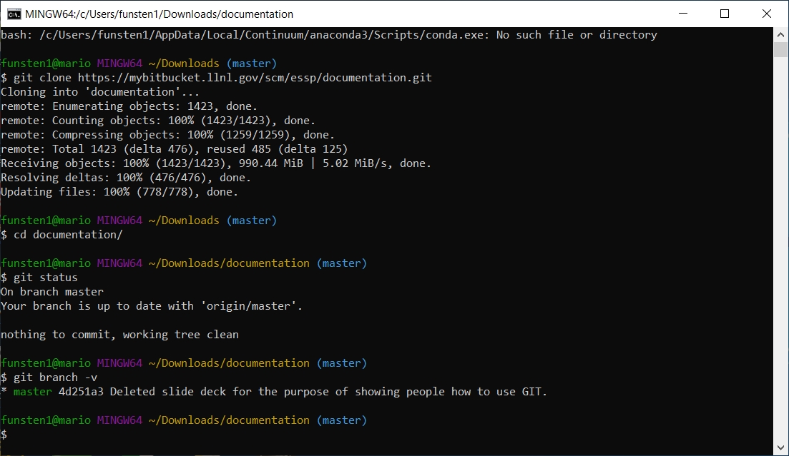
View what branch you are on and commit hash code with description: ‘git branch -v'

Slide 13
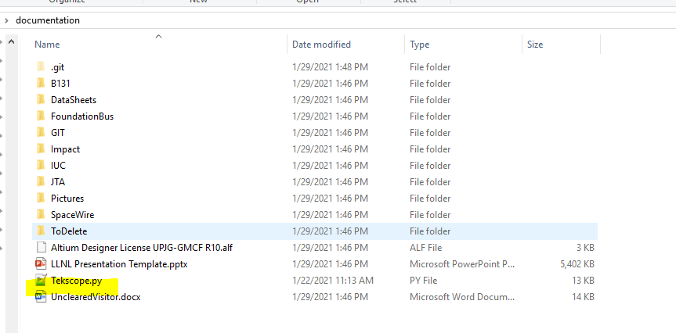
Modifying Repo: we are going to add a file to the repo (a python script)

Slide 14
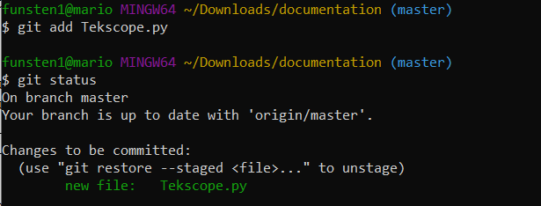
Track (also called add) file to eventually be committed and pushed to the repo:
Git commands:
git add <filename>: tracks the file to be pushed up
could use also: git add * → careful, it will add every file that has not been tracked
or git add *.py → will add all python scripts
git status: will state that there is a new file in green text

Slide 15
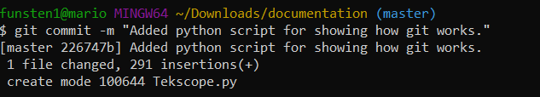
Commit the changes: git commit –m “<message>”

Slide 16
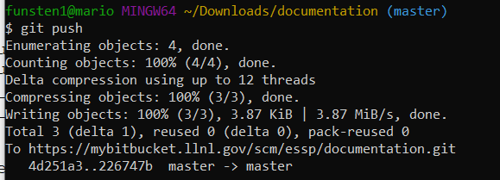
Pushing the commit to Bitbucket repo using ‘git push’

Slide 17

Viewing new commit

Slide 18
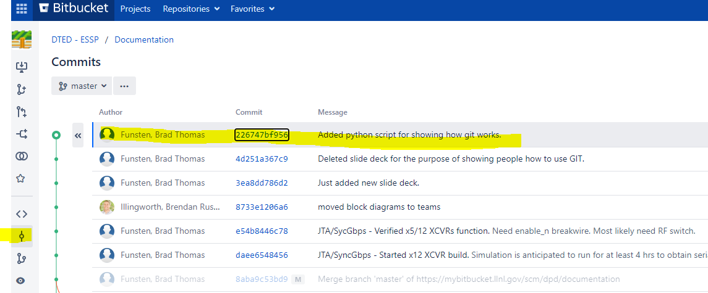
Viewing new commit in Bitbucket

Slide 19
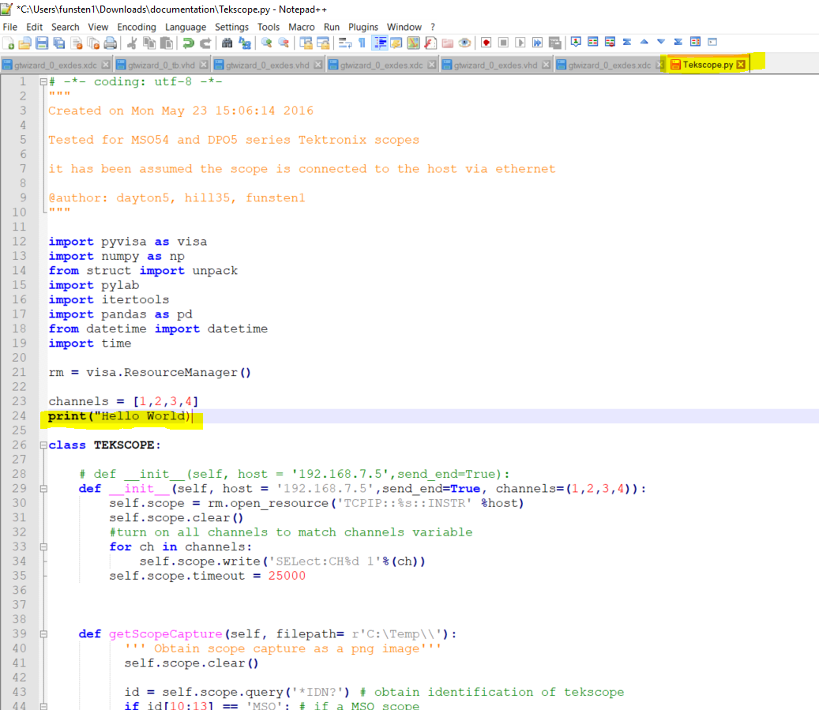
Now, let’s modify the python script that was pushed

Slide 20
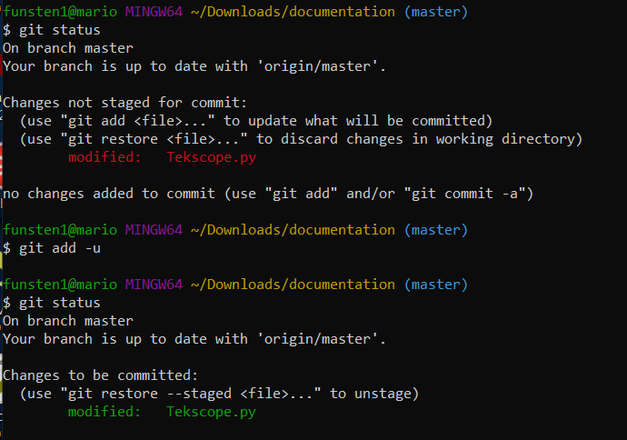
Once modified, you can check the status, track it, and then eventually push
Red text means, the file has not been tracked/added
Git command:
git add -u: updates the modified tracked files given our change
Check status: now the text is green meaning the file has been modified and tracked for committing/pushing

Slide 21
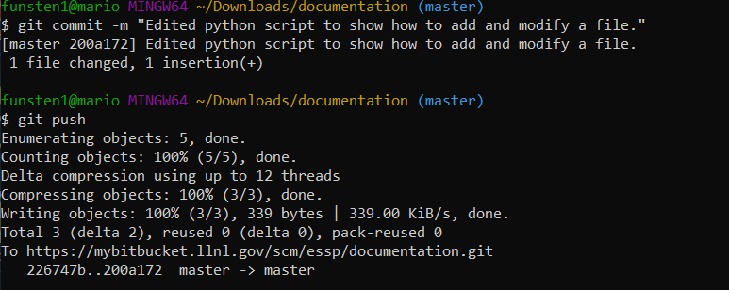
Commit and push change

Slide 22
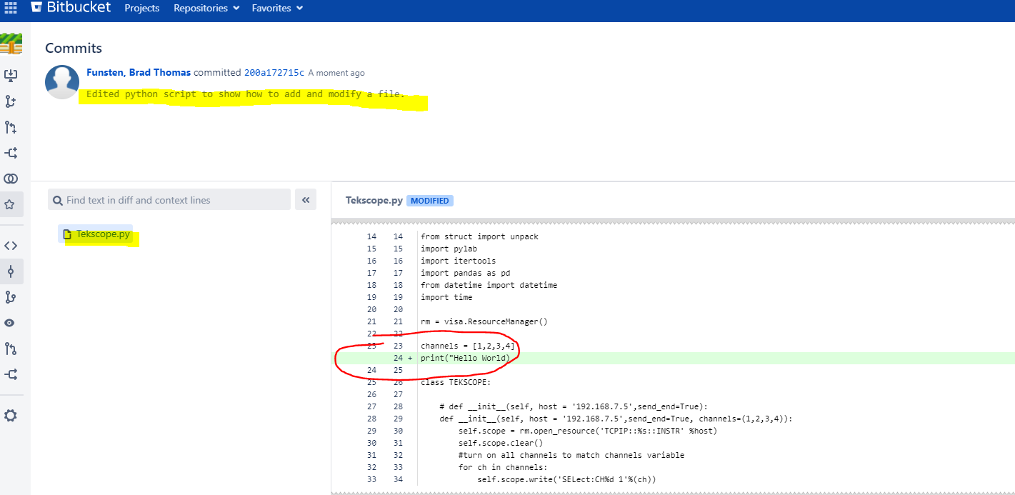
View change in Bitbucket Commit

Slide 23
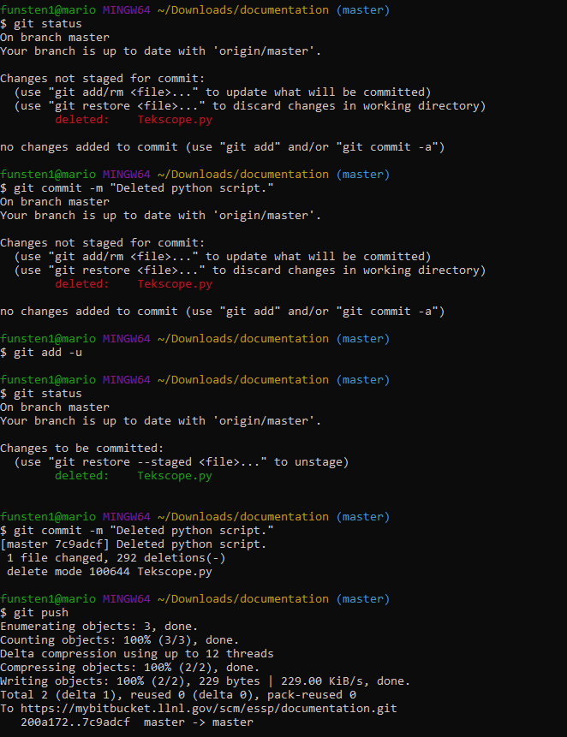
Now let’s delete the file and push the changes that we removed the file
Delete script through the windows explorer or use the command:
git rm <filename> → you might need a –f (e.g. git rm –f <filename> if git complains that it cannot delete file). –f forces a removal of the file
Use git status, commit, and push

Slide 24
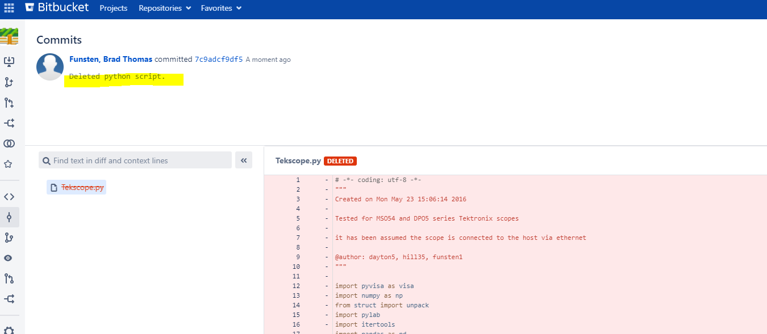
View that the file was deleted

Slide 25
Using GIT Bash Terminal GIF

Slide 26
Fixes to Issues

Slide 27
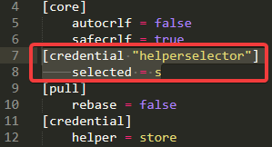
Credential Help Selector Pops up all the time
Prevents having to log in each time you push/pull/clone, etc.
Gitconfig credentials: https://git-scm.com/docs/git-credential-store
https://community.atlassian.com/t5/Bitbucket-questions/CredentialHelperSelector-keeps-popping-up-how-do-I-fix/qaq-p/1412630
Delete the option for the helper selector, rebooted, and have had no problem.

Slide 28
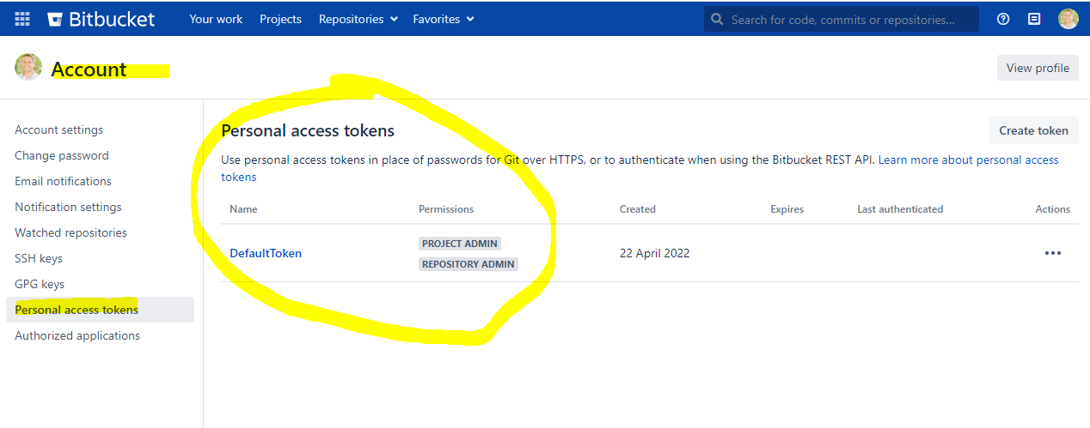
Token Issue in Bitbucket
Change default token when AD password changes.

Slide 29
Pushing up Large Files to GIT

Slide 30
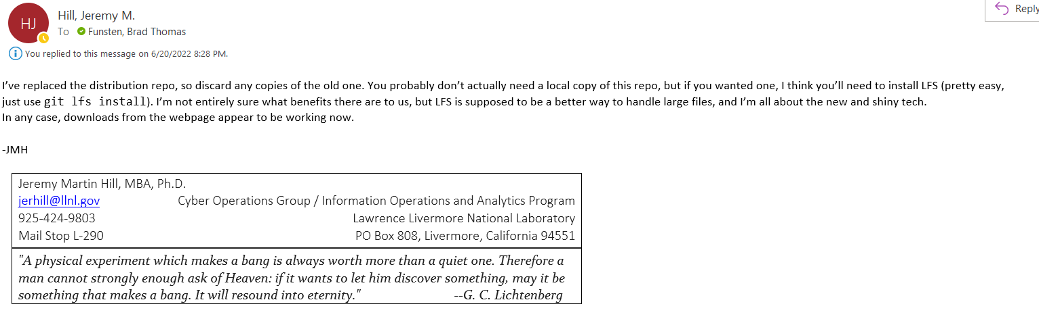
Pushing up Large Files to GIT
https://git-lfs.github.com/

Slide 31
Cleaning Files

Slide 32
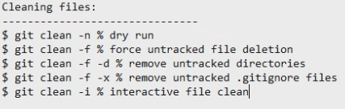
Cleaning Files → shows you what changes were to take place

Slide 33
Enable Long Filenames

Slide 34
Enable Long Filenames
git config core.longpaths true

